Slide 1
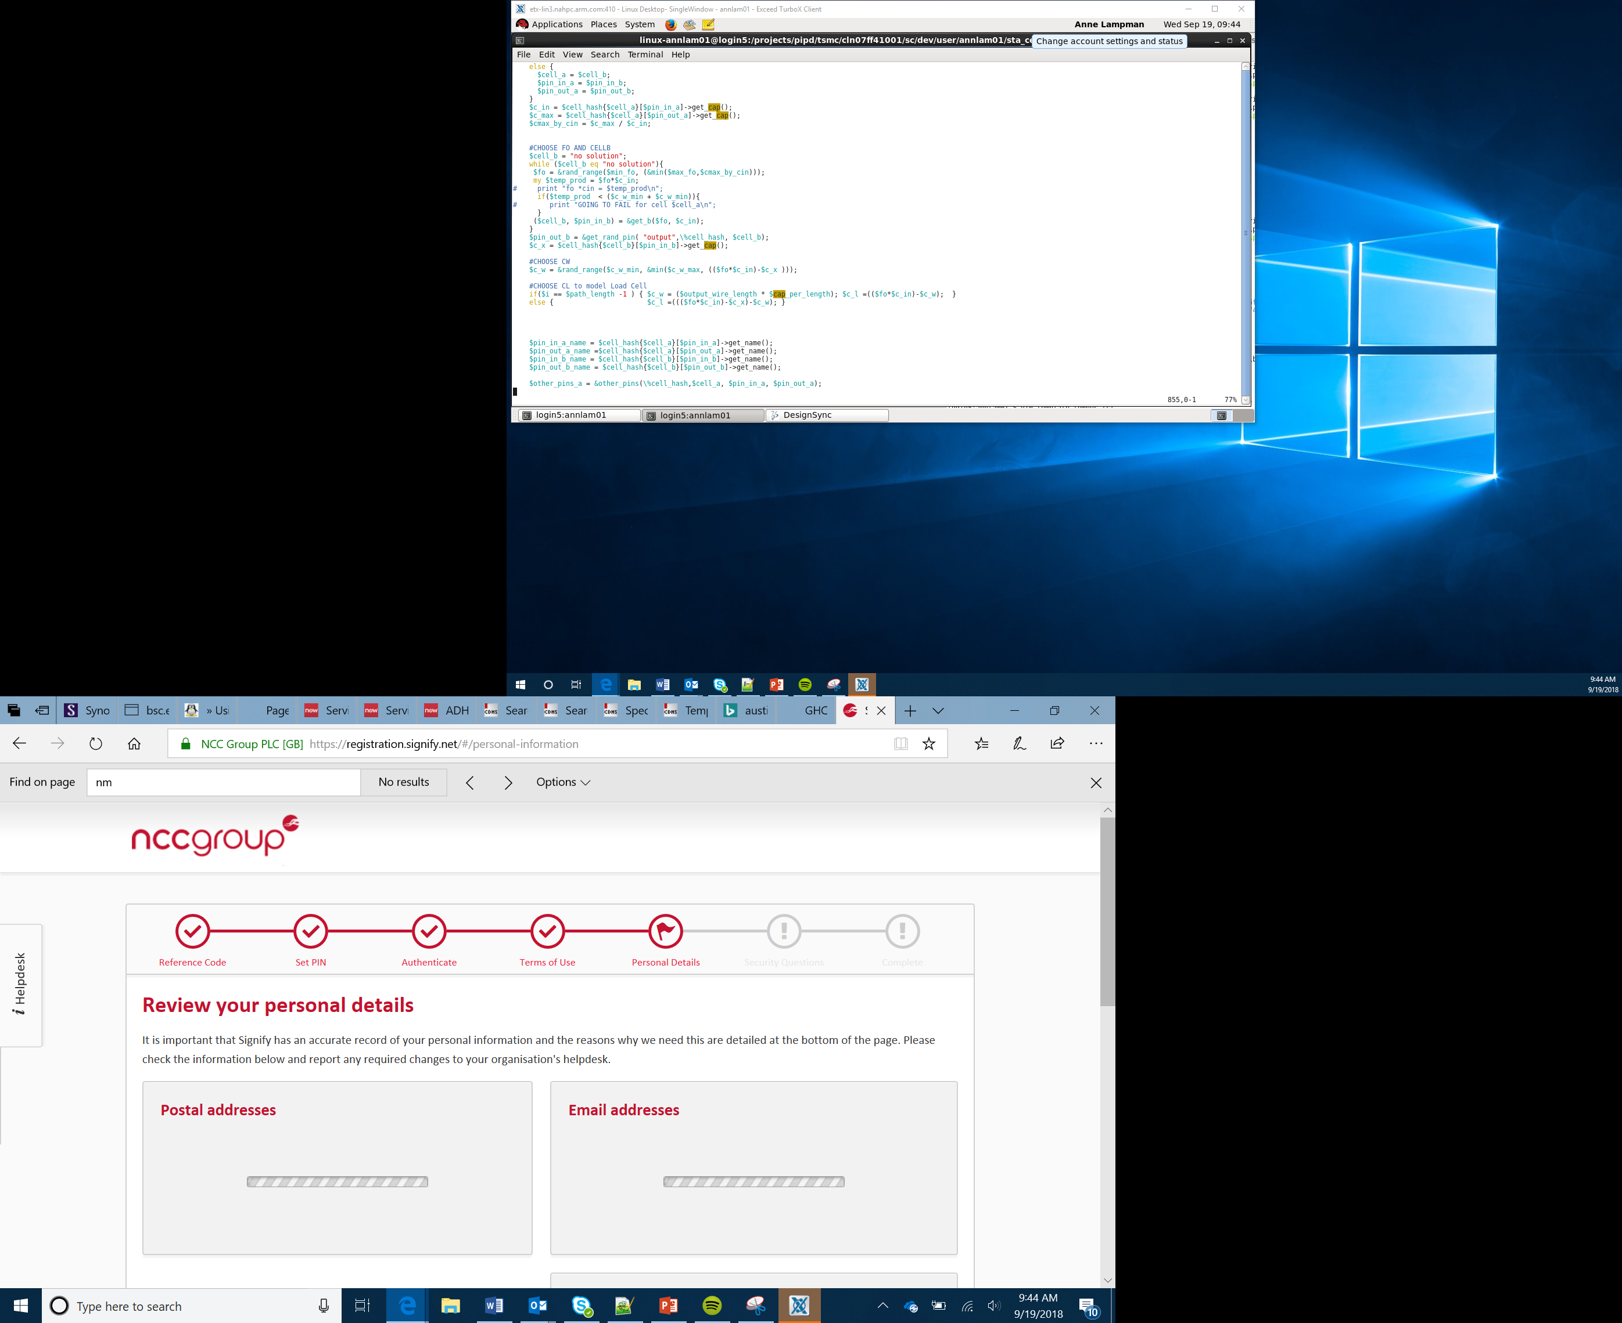

What is a micro:bit
Lesson 1

Slide 2
What the Lesson Will Cover
Introduction to the course
Theory and project lessons
Success criteria
Gracious professionalism
Notes:
Introduce the lesson and what it will cover, Learners could discuss or ask question about what the lesson might involve.

Slide 3
Theory lessons and project
Theory lessons
Projects
Learning about core theory
Covers computational techniques
Includes activities with success criteria
Typically done individually
Group tasks (typically groups of 4)
Requires teamwork and communication
Must work in parallel
Clear success criteria for both software and hardware
Typically involves designing and building a product to solve a problem

Slide 4
The four team roles
Project Manager:
Tasks being completed on time
Checking everything is complete
Storing the product and designs safely
Engineer:
Designing the product
Making the product
Testing the product
Developer:
Designing the IPO process
Programming the micro:bit
Testing the program
Marketing and communications:
Ensuring the team communicate
Creating the logo and branding the product
Writing the elevator pitch

Slide 5
Working in parallel
Project Manager
Engineer
Marketing and communications:
Developer
Lesson 1
Lesson 2
Checking everything is going to plan and safely storing the work every lesson and helping everyone
Designing the product
Making the product
Testing the product
Developing the logo
Branding the product
Writing the elevator pitch
IPO planning
Programming the micro:bit
Testing the program

Slide 6
Success criteria
These are the key objectives for the lesson/project
You need to plan your time to meet these criteria
Use these to check progress

Slide 7
Objectives
Be able to identify the key features of a micro:bit
Apply sequence and iteration coding techniques using MakeCode
Understand how to upload resources to the micro:bit
Notes:
Introduce the BBC micro:bit
A little bit of history into the BBC’s involvement with educational computing eg BBC Micro from the 80s
A look at the features of the micro:bit – nice comparison can be made to the Raspberry Pi but as a simpler way to get into physical computing
Discuss the importance of physical computing and the concept of the Internet of Things

Slide 8
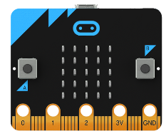
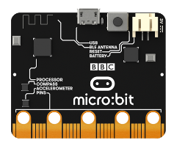
What is a micro:bit
The micro:bit is a pocket-sized computer
It has a 25 red LED matrix on the front along with 2 input buttons, A and B
It has a host of sensors built in including temperature, light, compass and acceleration
It supports Bluetooth LE (BLE) & Bluetooth radio for communication other devices or Internet of Things (IoT)
Through the input pins it can communicate with a range of additional hardware
Notes:
Talk through the following sensors
LED matrix duals as a light sensor
CPU Temp Sensor can be used to estimate external temperature
Buttons A and B
Accelerometer – movement sensor and orientation
Compass or magnetometer – use as a compass and metal detection
External pins for analogue and digital
Interfaces for I2C and serial devices
Bluetooth Low Energy (BLE) and Bluetooth radio services

Slide 9
Fail Early, Fail Often
Code development at all levels is challenging
You will make mistakes, even ‘Rock Star Coders’ like Steve Wozniak, Jeff Minter, Dennis Ritchie, etc all made and continued to make mistakes
‘Success is buried in the garden of failure – So keep digging’ Rick Wakeman
Notes:
Introduce the concept of failure and failure being a positive of not yet achieving or deferred success
Coding (and life) is about resilience – the ability to keep trying. If at first you don’t succeed. Try, try, try again!

Slide 10
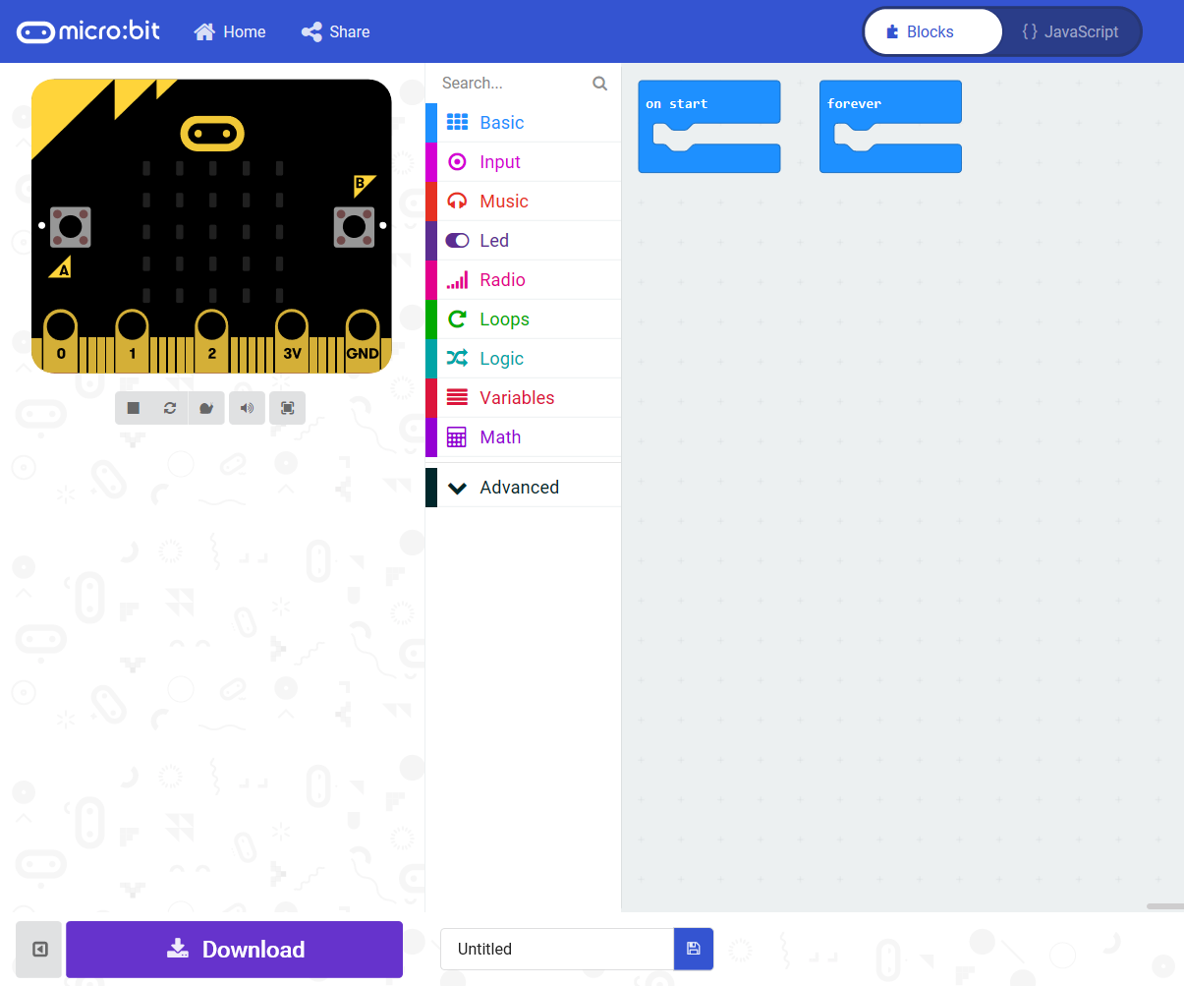
MakeCode
https://makecode.microbit.org/ is the website for developing applications using the micro:bit
Simulator
Block Selection
Development Area
Save and Download
Notes:
Discuss the features of the programming environment – check the simulator works and comes up. If it doesn’t this is likely to be down to blocking on your internal firewall.
Ensure that MakeCode is available before you start.
Ensure the following website are unfiltered (a constantly updated list is available at https://support.microbit.org/support/solutions/articles/19000030385-firewall-whitelist-requirements-for-micro-bit-editors)
You need access to USB devices if these are blocked by default all Micro:bits use the same ID – use your security policy to exempt the micro:bit ID
PXT / MakeCode/Javascript Blocks Editor:
pxt.microbit.org
makecode.microbit.org
makecode.com www.pxt.io trg-microbit.userpxt.io pxt.azureedge.net
github.com Blocks:
www.microbit.co.uk
Touch Develop:
www.microbit.co.uk
Code Kingdoms:
www.microbit.co.uk
microbit.codekingdoms.com
Python Web Editor (microbit.co.uk)
www.microbit.co.uk
Python Web Editor (microbit.org)
python.microbit.org

Slide 11
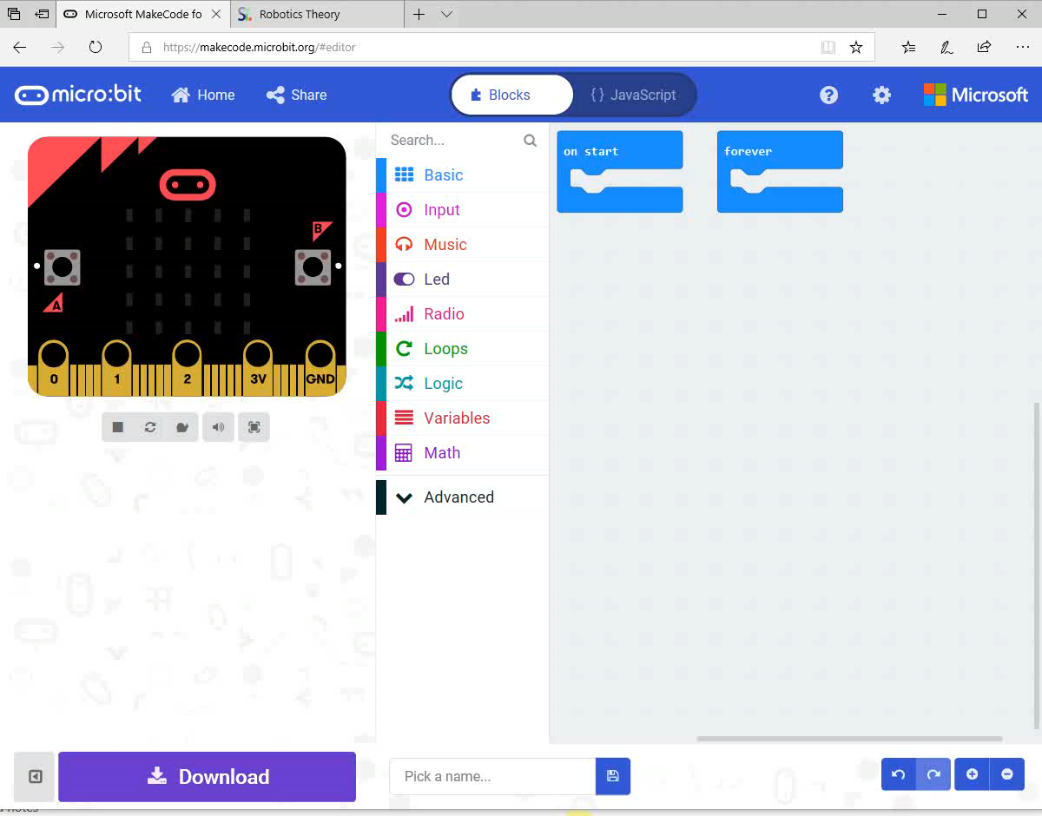
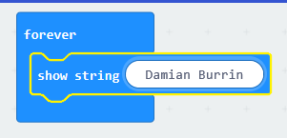
First App – Scrolling Name Badge
There is a four-step development process for working with MakeCode
Plan your idea
Build the Blocks
Test in the simulator
Download the file
Plan – I want to scroll my name on the micro:bit
Build - Use the block example to the right or the video to create your blocks
Test – Does it scroll on the simulator
Flash – Transfer the file to the micro:bit
Notes:
Walk through a simple ‘Hello World’ app – get them to display their name
Test first on the simulator – this will give you an indication if there is a filtering issue
Demonstrate the flashing process. It’s slightly different on Edge, Chrome, IE etc so ensure the students know how to manually copy files from their folders directly to the micro:bit as well as downloading directly
A copy of the video is on the next slide to make it easier to follow

Slide 12
Video
Notes:
This slide can be skipped if the video is large enough on a single PC on previous slide

Slide 13
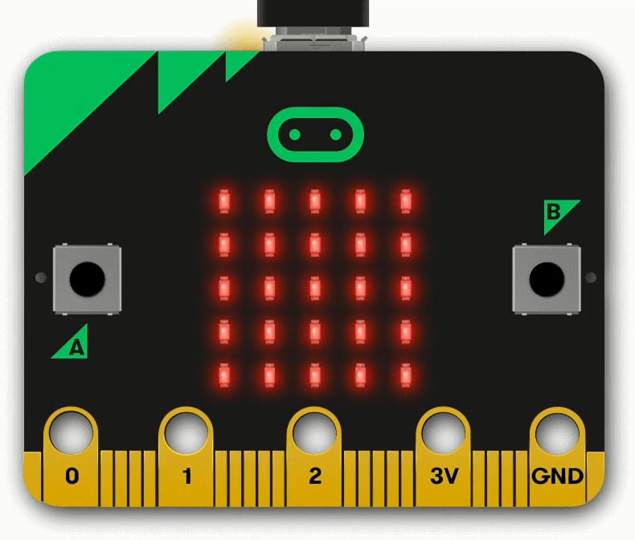
Step by Step
Go to https://makecode.microbit.org/
Click on Basic and drag the show string block
Change the test string to your name by double clicking
Check it works in the simulator
Give the file a name
Make sure your micro:bit is plugged into a USB port
Download and flash
The program will now run on the micro:bit
Notes:
After you demo leave this up get the students to work through the example.
Ask them to change the text
Ensure that they are able to flash the micro:bit and test it works away from the PC

Slide 14
Success Criteria
Why does it never stop? – try using the repeat block to make to scroll a fixed number of time
Use the built in icons to display a picture of a heart
Combine the big and small hearts to create a pulsing heart
Notes:
The best way to learn with the micro:bit is to play.
Give the students some time to experiment
Ensure they know that its ok to fail and it doesn’t matter if it doesn’t work first time
Students should be comfortable and happy try things for themselves

Slide 15
Predict & Investigate
What will happen if I add a delay before
or after my name? How can I change the length of the delay?
Why does it never stop? – try using the repeat block to make to scroll a fixed number of times
Use the built in icons to display a picture of a heart
If you want more control over images, don’t use the built in icons but design your own with show led block
Combine the big and small hearts to create a pulsing heart
Upload, test, how could it be improved?
Consider the use of delays
Notes:
The best way to learn with the micro:bit is to play.
Give the students some time to experiment
Ensure they know that its ok to fail and it doesn’t matter if it doesn’t work first time
Students should be comfortable and happy try things for themselves

